Slide 1
Secure data hiding in image using steganography
Image Steganography
Presented By: Harsh Parmar
Student Name : Harsh Parmar
College Name & Department : Vaish college, Bhiwani

Slide 2
OUTLINE
Problem Statement
Technology used
Wow factor
End users
Result
Conclusion
Git-hub Link
Future scope

Slide 3
Problem Statement
This project focuses on hiding secret messages within an image using basic steganography techniques. The aim is to provide a simple and secure method for encoding and retrieving hidden messages using pixel manipulation.

Slide 4
Technology used
Programming language: Python
Libraries used:
1. CV2(OpenCV) – For image processing
2. OS – This is used to interact with operating sustem

Slide 5
Wow factors
Lightweight and Simple: Uses basic pixel value changes instead of complex cryptography.
No External Dependencies: Requires only OpenCV and standard Python libraries.
Passcode Protection: Ensures only authorized users can retrieve the hidden message.

Slide 6
End users
Individuals needing secure communication.
Cybersecurity and cryptography enthusiasts exploring steganography.
Students & Researchers studying hidden data techniques.
Defence services used to keep the information confidential.

Slide 7
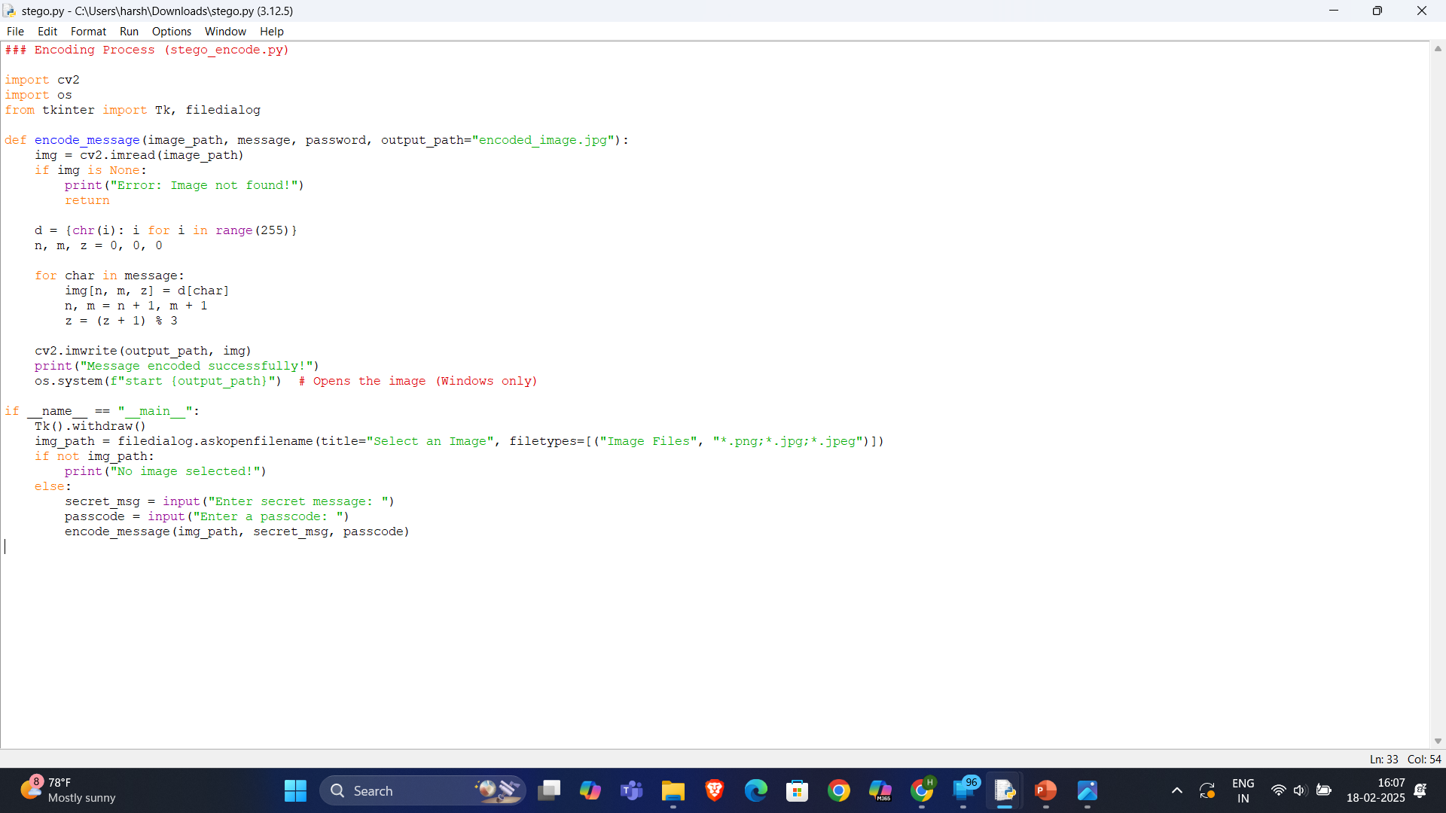
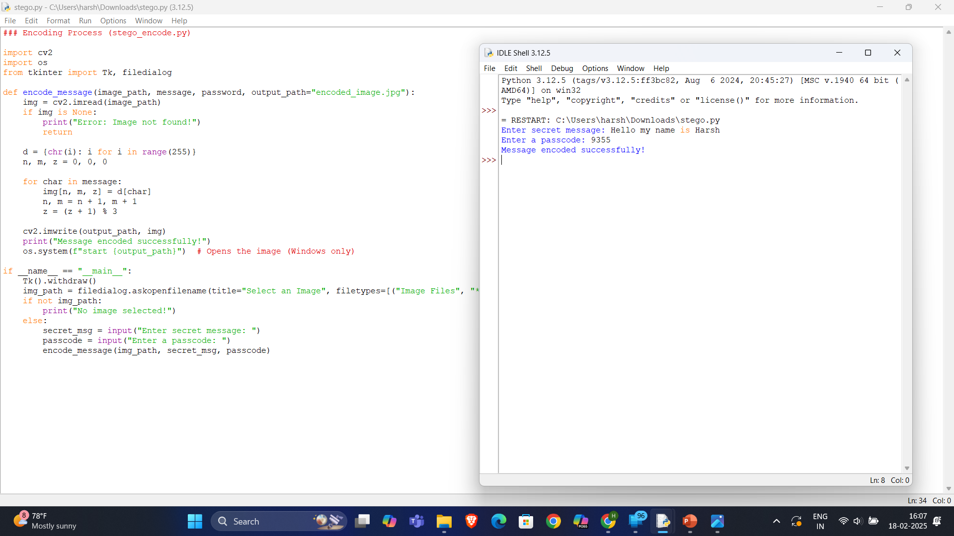
Results
Screenshots of the outcome (min 3)

Slide 8
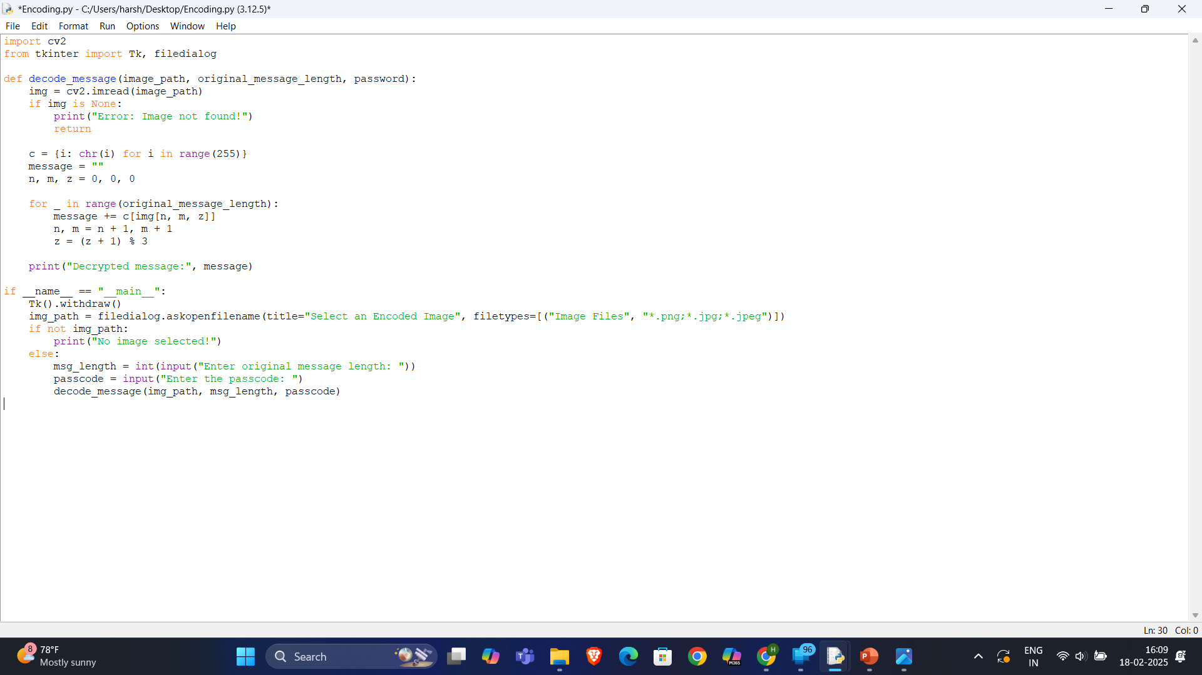
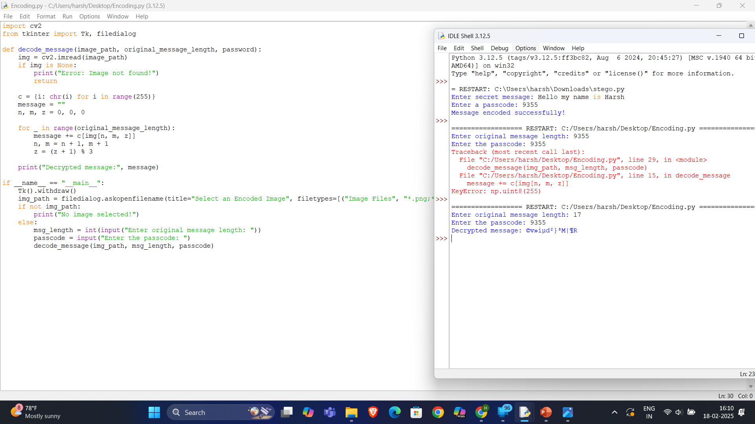
Results

Slide 9
Conclusion
This project demonstrates a basic steganography technique using pixel value modification. It provides a simple way to hide and retrieve messages securely. Future improvements can enhance security by using more advanced steganographic techniques.

Slide 10
GitHub Link
Github link: https: //github.com/harsh9360/Projectstego.git

Slide 11
Future scope(optional)
Use LSB Steganography: Modify only the least significant bits to avoid noticeable image changes.
Support for Multiple Image Formats: Extend beyond JPG, PNG etc.
Enhanced Encryption: Implement AES or RSA encryption before embedding messages.
Graphical User Interface (GUI): Develop a user-friendly interface for non-programmers.

Slide 12
THANK YOU

